Slide 1
The “Internet”

Slide 2
Scale Yourself
Learning Goal:
Students will be able to explain how the Internet works.
4 | I can explain how the Internet works. I can teach these skills to others.
3 | I can explain how the Internet works, without my notes
2 | With help, (my notes, teacher assistance) I can explain how the Internet works.
1 | I cannot explain how the Internet works.

Slide 3
Learning Targets
Explain how to access and connect to the Internet.
Describe the communication between two computers using simple networks.
Identify the six elements of how to connect to the Internet
Describe the client/server model

Slide 4
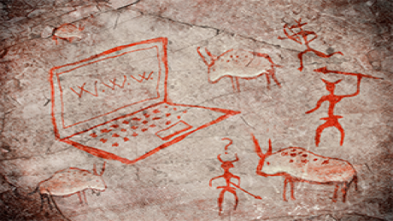
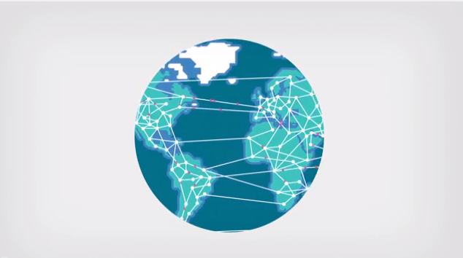
Origin of the Internet
The Internet is a vast network of computers (LANs and WANs) that electronically connects millions of people worldwide.

Slide 5
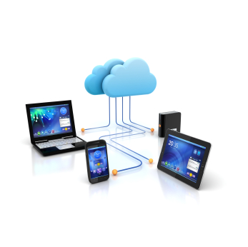
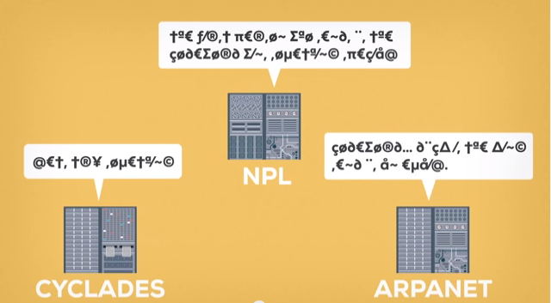
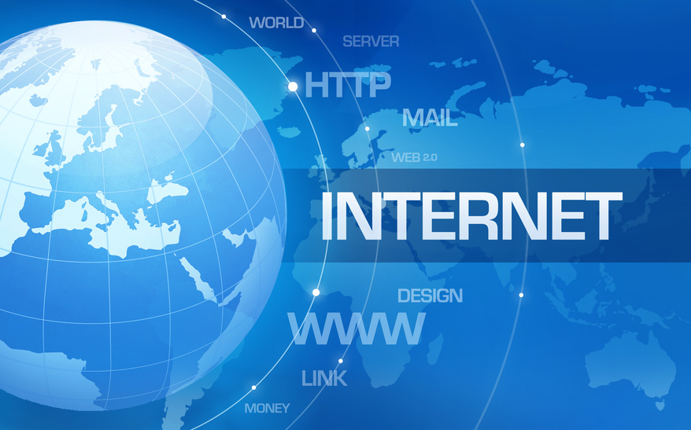
Creation of the Internet
3 separate inventions created the Internet.
ARPANET-US
NPL-Britain
CYCLADES-French
=

Slide 6
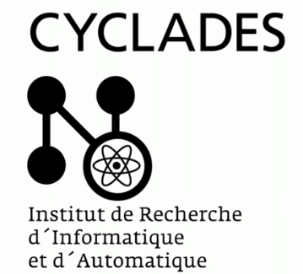
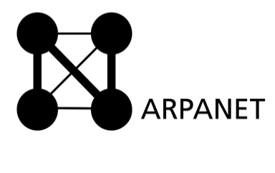
Creation of the Internet
ARPANET-US
Focused on time-sharing (how to share data)
NPL-Britain
Was a commercial network (money).
Came up with the idea of packet switching to avoid congestion on a network
breaking information into parts and put it together again when it gets the receiving computer
Cyclades-French
focused on direct connection between computers.
Came up with the word Internet.

Slide 7
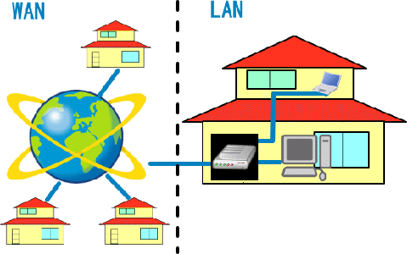
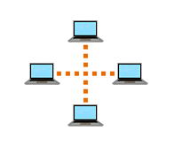
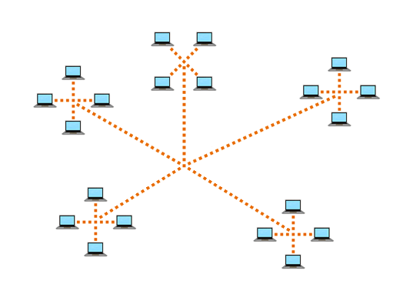
Computer Networks
There are two main types of computer networks:
Local Area Network (LAN): A LAN is two or more connected computers sharing certain resources in a relatively small geographic location, often in the same building. Examples include home networks and office networks.
Wide Area Network (WAN): A WAN typically consists of two or more LANs. The computers are farther apart and are linked by telephone lines, dedicated telephone lines, or radio waves. The Internet is the largest Wide Area Network (WAN) in existence.

Slide 8
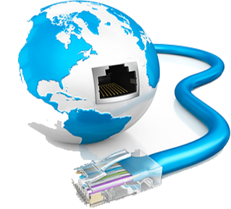
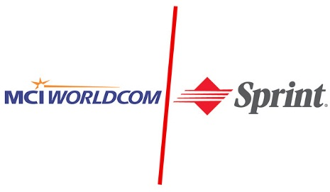
Internet
The Internet is the largest computer network in the world, connecting millions of computers.
A network is a group of two or more computer systems linked together.
The Internet is now maintained by the major Internet service providers such as MCI Worldcom, Sprint, GTE, ANS, and UUNET.
Many people think the Internet and the World Wide Web are the same thing. They're not!
It is one of the many features of the Internet. E-mail, FTP, and Instant Messaging are also features of the Internet.
http://techterms.com/definition/internet

Slide 9
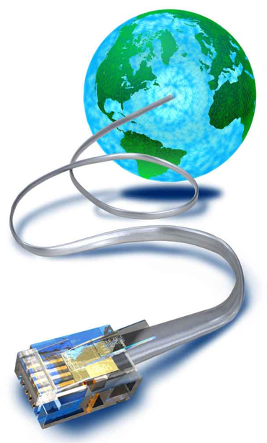
Connecting to the Internet
Six elements are required to connect to the Internet:
Computer
Operating system
TCP/IP
Client software
Internet connection (direct through an ISP)
Internet address

Slide 10
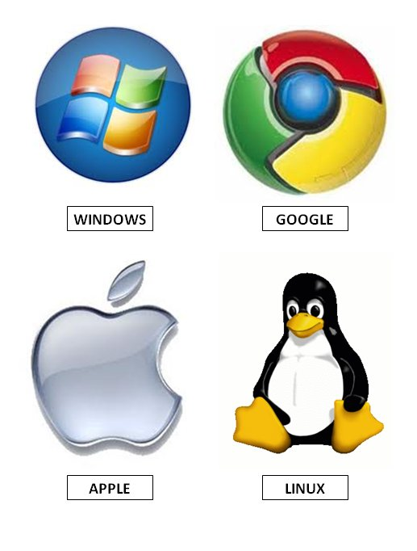
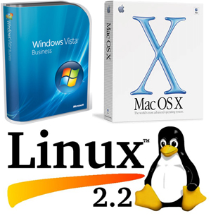
How the Internet Works
Six elements
Operating system
TCP/IP
Client software
Internet connection (direct through an ISP)
Internet address
Operating system-
the program that manages all the other programs (software and hardware) in a computer.
Examples:
Linux, Windows, VMS, OS/400

Slide 11
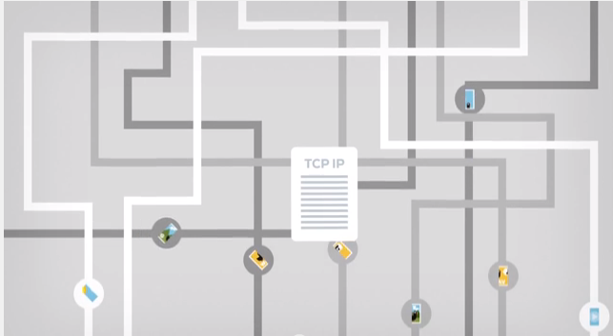
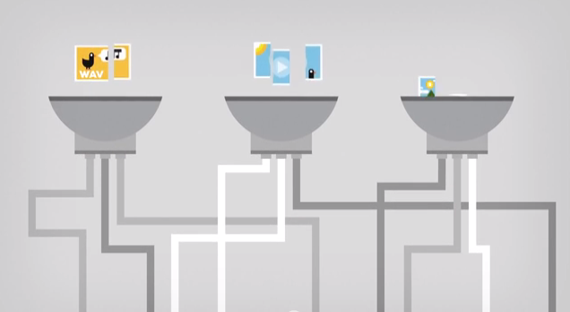
How the Internet Works
Six elements
Operating system
TCP/IP
Client software
Internet connection (direct through an ISP)
Internet address
TCP/IP- the basic communication language or protocol of the Internet
TCP (Transmission Control Protocol)-
manages the assembling of a message or file into smaller packets that are transmitted over the Internet and reassembled into the original message
IP (Internet Protocol)-
handles the address part of each packet so that it gets to the right destination.

Slide 12
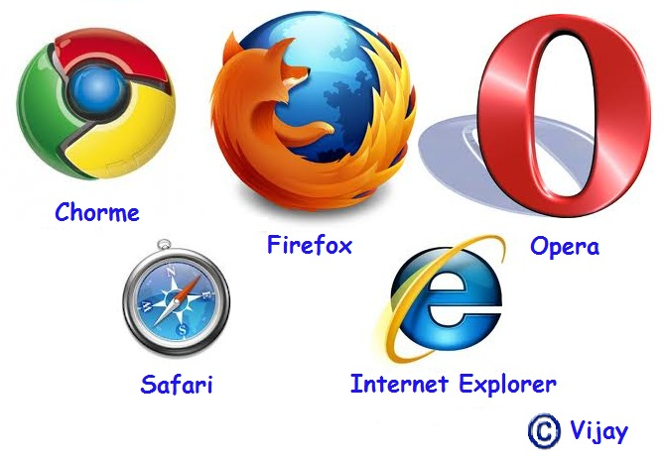
How the Internet Works
Six elements
Operating system
TCP/IP
Client software
Internet connection (direct through an ISP)
Internet address
Client Software-software that enables users to communicate with and request information from the server.
Examples: Web browser, e-mail or news client program

Slide 13
How the Internet Works
Six elements
Operating system
TCP/IP
Client software
Internet connection (direct through an ISP)
Internet address
Internet connection-connect through an ISP
Internet Service Provider (ISP)
An organization that maintains a gateway to the Internet and rents access to customers on a per-use or subscription basis.

Slide 14
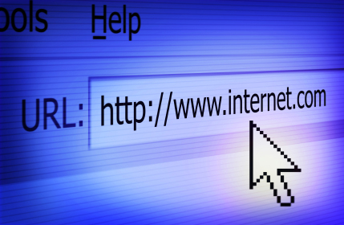
How the Internet Works
Six elements
Operating system
TCP/IP
Client software
Internet connection (direct through an ISP)
Internet address
Internet address
Web address (e.g., www.CIWcertified.com)
e-mail address (e.g.,student1@class.com)
server address (e.g., ss1.ciwcertified.com)

Slide 15
Thursday

Slide 16
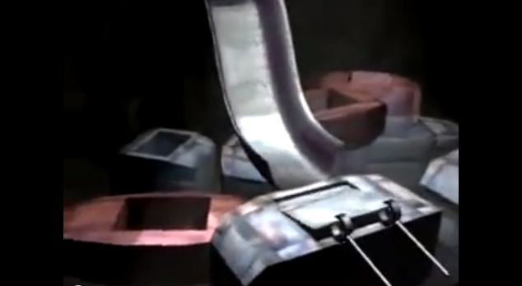
How the Internet Works
https://www.youtube.com/watch?v=7_LPdttKXPc
https://www.youtube.com/watch?v=HOaIqQAeaik

Slide 17
How the Internet Works
Six elements
Operating system
TCP/IP
Client software
Internet connection (direct through an ISP)
Internet address
Network protocols and packets:
Protocol – an agreed-upon format for transmitting data between two devices
Packet – a fixed piece of information sent across a network
Every computer connected to the Internet uses Transmission Control Protocol / Internet Protocol (TCP/IP)
TCP/IP – software that makes Internet communication possible

Slide 18
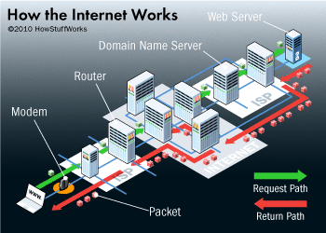
How the Internet Works (cont’d)
Computers access information from the Internet as follows:
You request data from an Internet server
The request is divided into packets
The packets are routed from your LAN to the Internet backbone
The packets are routed from the Internet backbone to the destination server
The destination server sends the requested information using the same process

Slide 19
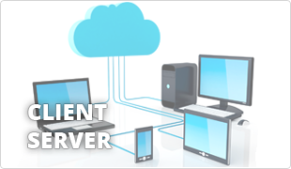
The client/server model
Many networks are structured using the client/server model, in which individual computers and devices, called nodes, interact with one another through a central server to which they are all connected.
The client/server model divides processing and storage tasks between the client and the server.
Client-an individual computer connected to a network
Server-A computer in a network that manages the network resources and provides, or serves, information to clients

Slide 20
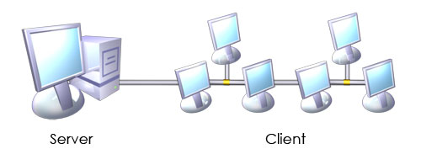
The client/server model
The server is more powerful than the individual computers, or clients, connected it.
The server is responsible for storing and presenting information.
Client/server model processes information as follows:
A client requests information from a shared file stored on the server
The server processes the request, locates the requested information and sends the information to the client
The client uses or processes the data as needed

Slide 21
Client/server relationship

Slide 22
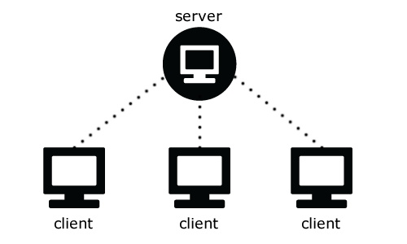
The client/server model
In a client/server environment, client programs run on the computer nodes and interact with a server program running on the server.
A network can accommodate more than one server.
Specific servers can be dedicated to making certain resources available to clients.
These resources can included printers, applications and documents.
Types of servers include:
Network servers, which manage the flow of data between them and client nodes
Print servers, which store shared data
Web servers, which manage access to the World Wide Web
Email severs which manage electronic mail

Slide 23
Client/server model example
Email is a technology that uses the client/server model.
To use email you must
Install and configure an email client/program on your computer
You can type an email, edit it repeatedly before sending, and work offline until your ready to access the network connection (Internet) and send
When you send the message, the email client computer connects to the network or Internet, transmit the message to an email server, and close the connection,
The message recipient can connect to his or her email server through a network or the Internet to retrieve the message

