Slide 1
The “Internet”

Slide 2
Software/Hardware needed to connect to the Internet
Before you can connect to the Internet, you need certain hardware and software in place, and you must choose a company to provide access to the Internet.
https://www.youtube.com/watch?v=hMX6dVa61t0

Slide 3
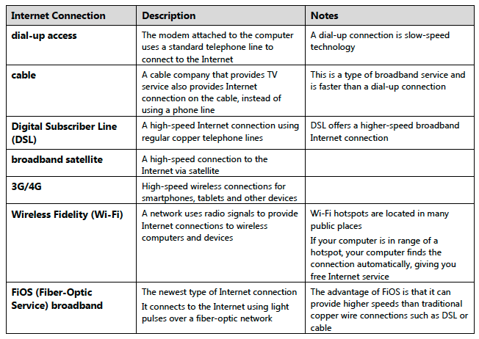
Various Types Of Internet Connections

Slide 4
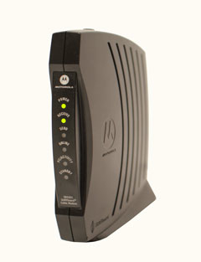
Hardware Needed
Modem
Once you have your computer, you really don't need much additional hardware to connect to the Internet. The primary piece of hardware you need is a modem.
The type of Internet access you choose will determine the type of modem you need. Dial-up access uses a telephone modem, DSL service uses a DSL modem, cable access uses a cable modem, and satellite service uses a satellite adapter. Your ISP may give you a modem—often for a fee—when you sign a contract, which helps ensure that you have the right kind of modem. However, if you would prefer to shop for a better or less expensive modem, you can choose to buy one separately.

Slide 5
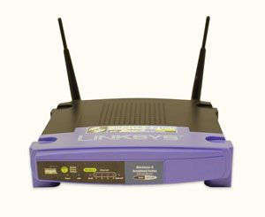
Hardware Needed
Router
A router is a hardware device that allows you to connect several computers and other devices to a single Internet connection, which is known as a home network. Many routers are wireless, allowing you to easily create a wireless network.
You don't necessarily need to buy a router to connect to the Internet. It's possible to connect your computer directly to your modem using an Ethernet cable. Also, many modems now include a built-in router, so you have the option of creating a network without having to buy more hardware.

Slide 6
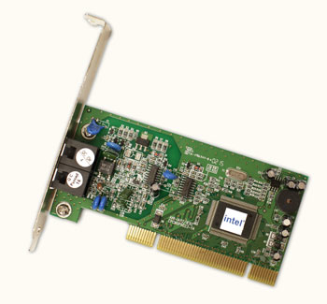
Hardware Needed
Network card
A network card is a piece of hardware that allows computers to communicate over a computer network. Most newer computers have a network card built into the motherboard, so it probably isn't something you'll need to purchase. The network card will have an Ethernet port, a wireless connection, or both.
If you have a laptop with a wireless connection, you can access the Internet at any place that offers a Wi-Fi connection. Many restaurants, coffee shops, bookstores, hotels, and other businesses offer free Wi-Fi. In addition, many cities provide free Wi-Fi in public areas such as parks and downtown areas.

Slide 7
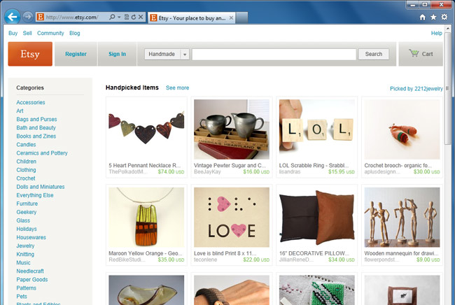
Hardware Needed
Web Browsers
A web browser is the tool you use to access the Web. The browser's main job is to display webpages. It also lets you create bookmarks—sometimes called Favorites—for sites you like so you can easily find them again later.

Slide 8
Classwork
Internet Connection Terms handout

Slide 9
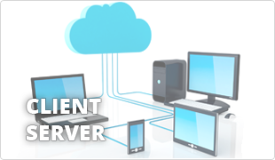
The client/server model
Many networks are structured using the client/server model, in which individual computers and devices, called nodes, interact with one another through a central server to which they are all connected.
The client/server model divides processing and storage tasks between the client and the server.
Client-an individual computer connected to a network
Server-A computer in a network that manages the network resources and provides, or serves, information to clients

Slide 10
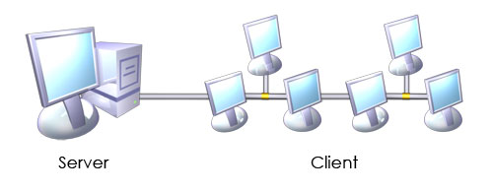
The client/server model
The server is more powerful than the individual computers, or clients, connected it.
The server is responsible for storing and presenting information.
Client/server model processes information as follows:
A client requests information from a shared file stored on the server
The server processes the request, locates the requested information and sends the information to the client
The client uses or processes the data as needed

Slide 11
Client/server relationship

Slide 12
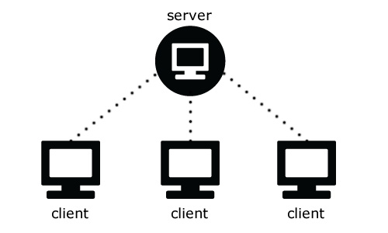
The client/server model
In a client/server environment, client programs run on the computer nodes and interact with a server program running on the server.
A network can accommodate more than one server.
Specific servers can be dedicated to making certain resources available to clients.
These resources can included printers, applications and documents.
Types of servers include:
Network servers, which manage the flow of data between them and client nodes
Print servers, which store shared data
Web servers, which manage access to the World Wide Web
Email severs which manage electronic mail

Slide 13
Client/server model example
Email is a technology that uses the client/server model.
To use email you must
Install and configure an email client/program on your computer
You can type an email, edit it repeatedly before sending, and work offline until your ready to access the network connection (Internet) and send
When you send the message, the email client computer connects to the network or Internet, transmit the message to an email server, and close the connection,
The message recipient can connect to his or her email server through a network or the Internet to retrieve the message

