Slide 1
Midterm Study Guide

Slide 2
Lesson 1

Slide 3
IT Job Roles
Web site designer
Web application developer
Web architect
Mobile application developer
Web site analyst
Web site manager
Database administrator/ specialist
Server administrator
Network engineer
Security manager
Security analyst/consultant
SEO analyst
Web marketing manager
Blog manager
PC and mobile-device repair technician
Help desk technician

Slide 4
Creating a Résumé
Formatting a résumé:
Create using a word-processing program
Microsoft Word, OpenOffice Writer or Google Docs
Use formatting to increase visual appeal
Recipient needs same word-processing program to be able to read résumés
Text format résumés:
Contain little formatting
Intended for keyword-searchable résumé databases and applicant tracking systems
RTF (Rich Text Format) résumés:
Incorporate basic formatting techniques
Can be read by many different programs on many different platforms
Combine the best qualities of formatted and text résumés
Best choice if you intend to send your résumé as an e-mail attachment and you do not know the file type that your recipient prefers
You can use WordPad to create this résumé or save it as a RTF file

Slide 5
Creating a Résumé (cont’d)
PDF (Portable Document Format) résumés:
Compatible across all computer platforms
Not vulnerable to viruses
Need PDF software
HTML résumés:
Posted as Web pages or sent as HTML-based e-mail messages
Retain the formatting characteristics of a word-processing file

Slide 6
Education and IT Careers
University degrees are available in:
Computer science
Computer engineering
Management information systems
Employers are also looking for:
Interpersonal skills
Business skills
Project management skills

Slide 7
Technology Adoption Models
Paradigm shift
Moore's Law
Technology adoption life cycle
Diffusion of innovation

Slide 8
Paradigm shift
Paradigm- a common belief in a theory and its principles
Paradigm shift – a change from one way of thinking to another
When a paradigm shift occurs, an intellectual “battle” frequently takes place between those who adopt the new paradigm and those who cling to the old paradigm

Slide 9
Moore's Law
Moore's Law – an analogy for advances in technological innovation
In 1965, Intel co-founder Gordon E. Moore predicted the overall processing power for computers will double every two years. This became known as Moore’s Law. It continues to hold true for almost every measure of capabilities for electronic devices.

Slide 10
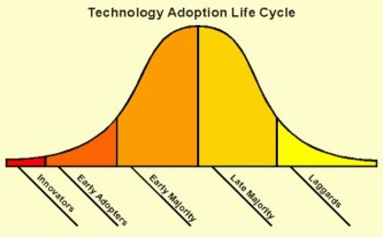
Technology adoption life cycle
Technology adoption life cycle – the degree to which members of a population will adopt or accept a new product or innovation
Adoption life cycle:
Innovators
Early adapters
Early majority
Late majority
Laggards

Slide 11
Business Modeling
Ontology
Business ontology
Ontology and IT
Web Ontology Language (OWL)

Slide 12
Purpose of an ontology
An ontological study is a foundational step for programmers and designers of complex information technology systems.
If properly conducted, an ontology allows software engineers and programmers to accurately map technology solutions to business models.
It can help ensure that data is formatted in a universal manner so that it can be reused from one system to another.

Slide 13
Ontology and the business organization
Business ontology – describes the flow of information through a business hierarchy
A business ontology can be a description of the hierarchical organization structure of the business and how the various objects relate to each other.
Hierarchy-any system of persons or things ranked one above another.

Slide 14
Ontology and the business organization
In large organizations,
Top level managers
generally consist of the chief executive level.
Below top-level managers are middle level managers
Directors and employees with managerial titles such as general manager, plant manager, regional manager, sales manager, and so forth.
Responsible for carrying out the goals set by top management by directing the activities of particular departments or other business units.
First-level managers
Managers in the levels below middle managers who are generally known as first-line managers or supervisors.
Office managers, department managers, store managers,etc

Slide 15
Lesson 8

Slide 16
Spam
Some actions you can take to minimize the spam you receive include:
Avoid adding yourself to unwanted mailing lists
Conduct online transactions through secure web sites
Do not assume that only the intended recipient will read your messages
Be selective when posting information to newsgroups

Slide 17
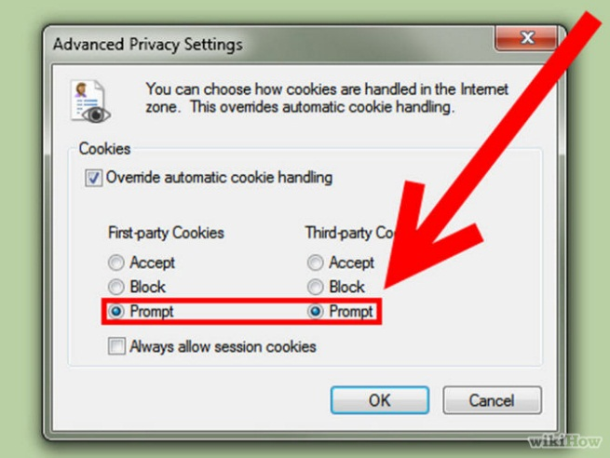
Cookies
Cookie types:
Persistent- stored as a file on your computer and remains there after you end your browser session.
Session-stored only during the current browsing session and is deleted from your computer when you close your browser.
First-party-comes from a web site you are currently viewing
Third-party- comes from a web site other than the one you are currently viewing.
a person or company other than you and the owner of the website you visit

Slide 18
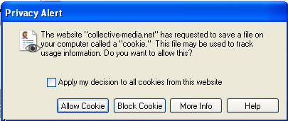
Cookies
You can control when and from whom cookies are accepted by specifying the level of privacy you want to maintain
You can view the file content of cookies to see information about the web site that sent them to you

Slide 19
Configuring Browser Security
You can configure you browser for added security by controlling active content that is downloaded from a web site and run locally on the clients browser.
The most common active content are JavaScript and ActiveX controls.
Both JavaScript and ActiveX controls allow information to be downloaded and run on your system.
JavaScript-object-oriented computer programming language commonly used to create interactive effects within web browsers.
Configure: arrange or order (a computer system or an element of it) so as to fit it for a designated task.

Slide 20
SSL and TLS
Secure sockets layer (SSL) – a protocol for secure exchanges
Authenticates using digital certificates
Transport layer security (TLS) ides for data encryption
– successor to SSL
Becoming more common
Based on SSL 3.0
Provides for encryption and authentication

Slide 21
Secure Protocols
Various protocols in the tcp/ip suite can be made secure by running them over ssl/tls, including:
HTTPS
S/FTP
IMAPS
POP3S

Slide 22
Malware (Malicious Software)
Virus – damages computers and networks, often alters files to damage or destroy data
Worm – resides in active memory and replicates itself until an entire disk is full
Trojan – appears to be harmless (such as a computer game) but produces harmful results
Illicit server – installs hidden services on systems
Client code – allows remote access to a computer by an attacker
Server code – infects destination computer and enables the attacker to control it

Slide 23
Spyware and Virus Removal
Spyware – an application secretly placed on a user’s system to covertly gather information and relay it to outside parties, usually for advertising purposes
Also known as adware
Cookies are not spyware because:
The user is aware of their presence
The user has the option to disable outside access to cookie information
Use spyware detection applications to detect and eliminate spyware

Slide 24
Updates and Patches
Update – a software upgrade that permanently fixes known bugs and improves software performance
Patch – a temporary bug fix
Virus update – files of virus signature profiles you use to keep your anti-virus software current

Slide 25
Typosquatting
Typosquatting – registering a domain name similar to a high-volume site hoping to receive traffic from users seeking the high-volume site who mistakenly enter an incorrect URL in the browser
Also known as URL hijacking
A typosquatter's web address can be:
A common misspelling of the victim's site
A foreign language misspelling of the victim's site
A misspelling based on the transposition of letters
A plural version of a singular domain name, or vice versa
A different top-level domain

Slide 26
Firewalls
Firewall – a collection of hardware, software and corporate policies that prevents unauthorized access to or from private networks
Use firewalls to:
Prevent unauthorized internet users from accessing private networks
Retain control of proprietary information
Prevent unauthorized export of proprietary information
Firewalls may prevent access to external e-mail providers or external servers

Slide 27
Security-Related Ethical and Legal Issues
Privacy concerns:
Your computer activities are no longer private
You may receive malware and spam
Organizations may monitor employee e-mail and restrict access to internet sites
Network administrators may audit the contents of employee hard drives
Use home computer for personal communications and internet searches

Slide 28
Lesson 6

Slide 29
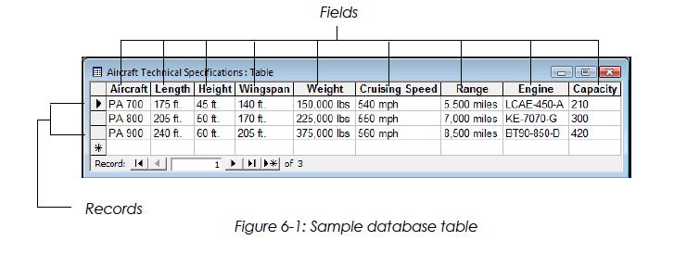
Overview of Databases
Database – an organized collection of information that pertains to a particular subject or purpose
Table – a collection of data about a specific topic, organized into columns and rows
Field – a category of information in a table (a column)
Record – a collection of information consisting of one or more related fields about a specific entity (a row)

Slide 30
Relational Databases
A relational database contains multiple tables of information that are related through common fields.
By contrast, a non-relational database consists of multiple tables of information that are not related through common fields.
When multiple tables have a field in common, they can be joined to form a relationship to access the table data as needed.

Slide 31
Relational Databases
Relational database – a database that contains multiple tables related through common fields
Common field – a field, contained in two or more tables, that forms a relationship between the tables
Relationship – a connection between two or more tables based on a common field
Relating tables eliminates the duplication of data

Slide 32
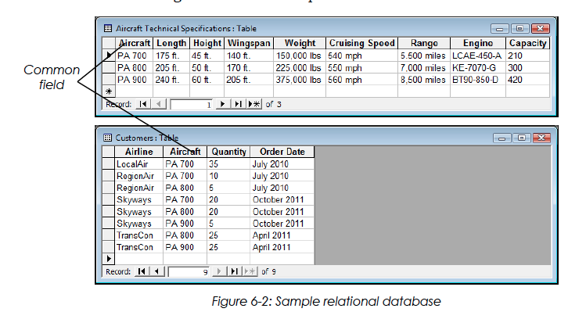
Relational Databases
To understand the relational database concept, consider a simple database designed for an aircraft manufacturer with three new aircrafts that will enter production soon.
The manufacturer wants to keep track of aircraft orders, as well as technical information about each aircraft.

Slide 33
The Customers table contains information only about the aircraft ordered by each airline; it does not contain information about the aircraft.
The Aircraft Technical Specifications table contains information only about the aircraft.
The only field the two tables have in common is the Aircraft field; the tables are related through this common field.
Relating the two tables can save time and eliminate data duplication.

Slide 34
Relational Databases
A table relationship is established by matching data in key fields between two database tables.
In any given relationship, the table in which the common field is the primary key is called the primary table.
The other table in the relationship is called the related table. The common field in the related table is called the foreign key.
A database table can have only one primary key.
Think about the example table:
The Aircraft field is the primary key in the Aircraft Technical Specifications table because the information is unique.

Slide 35
Relating Database Tables
Three types of relationships can be established between database tables:
One-to-one
One-to-many
Many-to-many

Slide 36
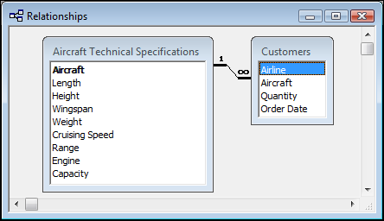
Relating Database Tables
A
B
One-to-many relationship – a record in Table A can have many matching records in Table B, but a record in Table B has only one matching record in Table A (the most common table relationship)

Slide 37
Relating Database Tables
A
B
One-to-one relationship – each record in Table A can have only one matching record in Table B

Slide 38
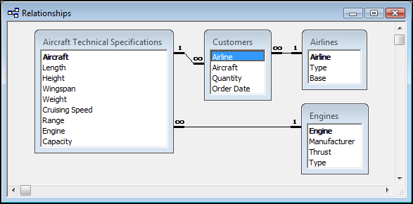
Relating Database Tables
B
A
Many-to-many relationship – one record in either Table A or B can relate to many matching records in the other table
Established by creating multiple one-to-many relationships with a third table (junction table)

Slide 39
Querying Databases Using SQL
Users input queries to selectively view and analyze data from a database.
A query isolates and displays only the information you want to examine by specifying the fields and records you want to see.
For example, you can use a query to display only the cruising speed, range and capacity of the aircraft that TransCon ordered.

Slide 40
Querying Databases Using SQL
There are three general types of queries:
Menu query — You are offered a list of options in a menu from which to choose.
Query by example — You specify the fields and data values to be used in a query.
Query language — You use a specialized language called Structured Query Language (SQL) to retrieve and manipulate information in a database.
Structured Query Language (SQL) – the standard interactive and programming language for accessing information from and updating information in relational databases

Slide 41
Introduction to Web Search Engines
Search engine – a powerful software program that makes it easy to find information on the Internet
Use keywords to find information about any subject you want to investigate
Many engines use "robots" or "spiders" to automatically search the Web and index Web sites

Slide 42
Registering a Web Site with a Search Engine
Add your Web site to search engines to make it available to Web users
Register your site by completing an online form and entering the URL of your site
Robots search your site for relevant keywords found in the <meta> tag
Search engines that scan Web pages for <meta> tags are called meta search engines

Slide 43
The <meta> Tag
The <meta> tag is an HTML element used in a Web page to embed information for use by search engines.
This information is placed near the top of the HTML document so search engines can quickly access it.
The more descriptive the information included in the <meta> tag, the more likely the Web site is to rank high in search results.
The <meta> tag includes information about a document, such as:
Keywords to be used by some search engines.
A description of the site's content for display in some search engines.
An expiration date for the document.
The document's author.

Slide 44
Search Engines vs. Information Portals
The term search engine is used loosely to refer to search engines and information portals
Search engine – uses a robot or spider program to browse the Web following hyperlinks, and index the content that it finds
Information portal – only finds Web sites based on manual submissions
Information portals are more likely to contain high-quality content matches to any given query

Slide 45
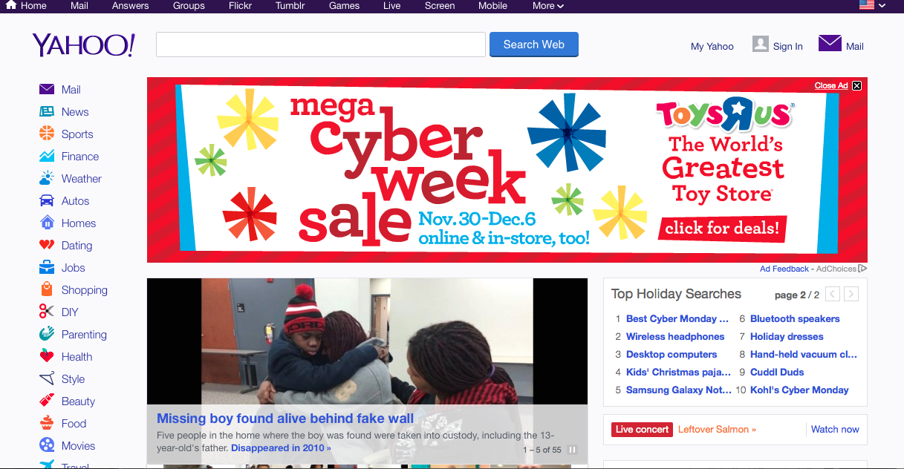
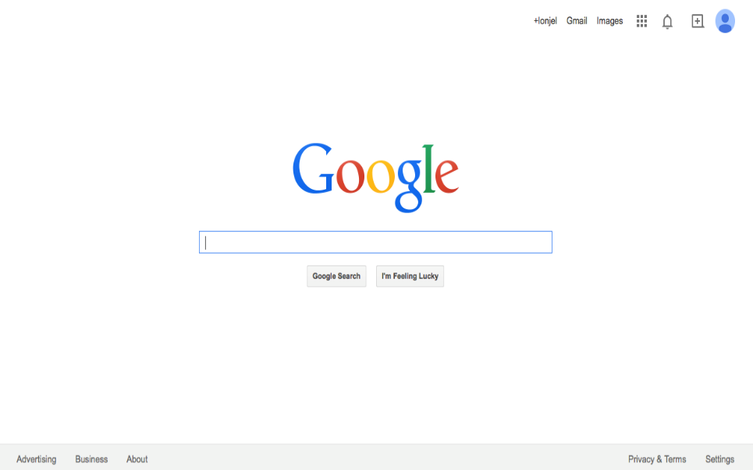
Search Engines vs. Information Portals
Yahoo-Information Portal
Google-Search Engine
Google only allows users to conduct searches
Information organized like the a directory.

Slide 46
Types of Web Searches
You can perform two types of searches with search engines:
Directory search – search engine displays a list of categories and subcategories that you can browse to find information
Static index/site map
Keyword search – you enter keywords in a search engine to query an index
Keyword index
Full-text index

Slide 47
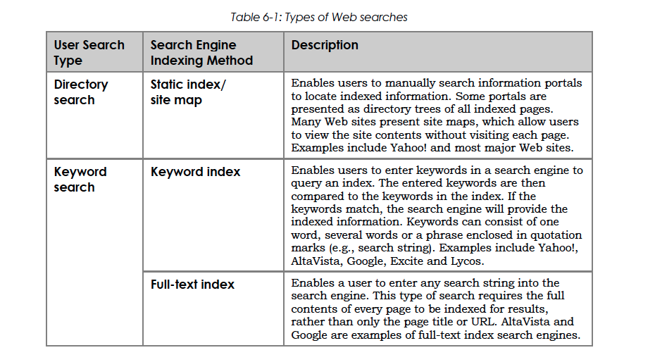

Slide 48
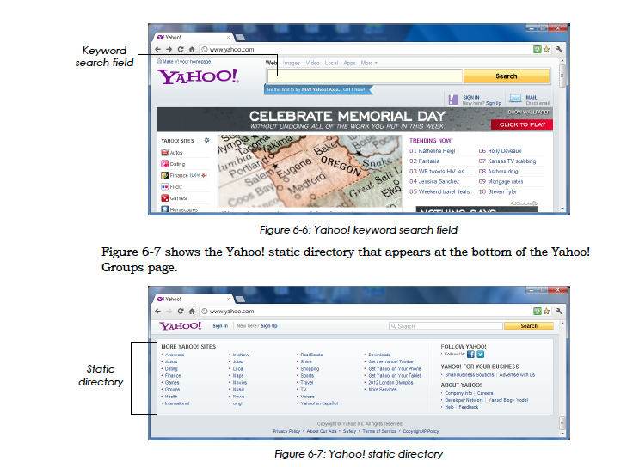

Slide 49
Basic Web Searching Techniques
Click hyperlinks in an information portal to access categories and subcategories to reach the desired information (e.g., Yahoo!)
Enter a single keyword to find Web pages containing the keyword
Enter multiple keywords to find Web pages containing all keywords
Enter multiple keywords within quotation marks to find Web pages in which the keywords must appear together in order

Slide 50
Popular Search Engines
Yahoo!
One of the oldest and most basic information portals
Yahoo was not intended to be a search engine; it was intended to provide multiple links relating to each topic
Google
Ranks relevance of a site based on keywords entered by the user
Also determines relevance based upon how many hyperlinks are made to a site

Slide 51
Popular Search Engines (cont’d)
Bing
Provides search suggestions as queries
Searches a user's social network (Facebook and Twitter)
Excite
Allows keyword searches
Contains cross-referencing fields for conceptual searches
WebCrawler
Fast, simple and reliable
Good for general searches

Slide 52
Boolean Operators
Boolean operators – symbols or words used to narrow Internet search results by including or excluding certain words or phrases from the results
Common operators:
AND, OR, NOT, NEAR, FAR, BEFORE, ADJ (adjacent)
Plus sign ( + )
Minus sign ( - )
Brackets ( [ ] )
Quotation marks ( " " )
Asterisk ( * )
Period ( . )

Slide 53
Advanced Web Searching Techniques
Use Boolean operators to narrow the focus of your search
Examples:
To include both keywords:
keyword1 AND keyword2 (results must include both keywords)
keyword1 + keyword2 (results must include both keywords)
To exclude keywords
keyword1 NOT keyword2 (results must exclude keyword2)
keyword1 – keyword2 (results must exclude keyword2)
To include at least one keyword:
keyword1 OR keyword2 (results must include at least one of the keywords)

Slide 54
